Slide 1
Multi-sensor unified data collection for responsive astronaut biometrics
MUDCRAB Technologies
Team 310 10/20/2023

Slide 2
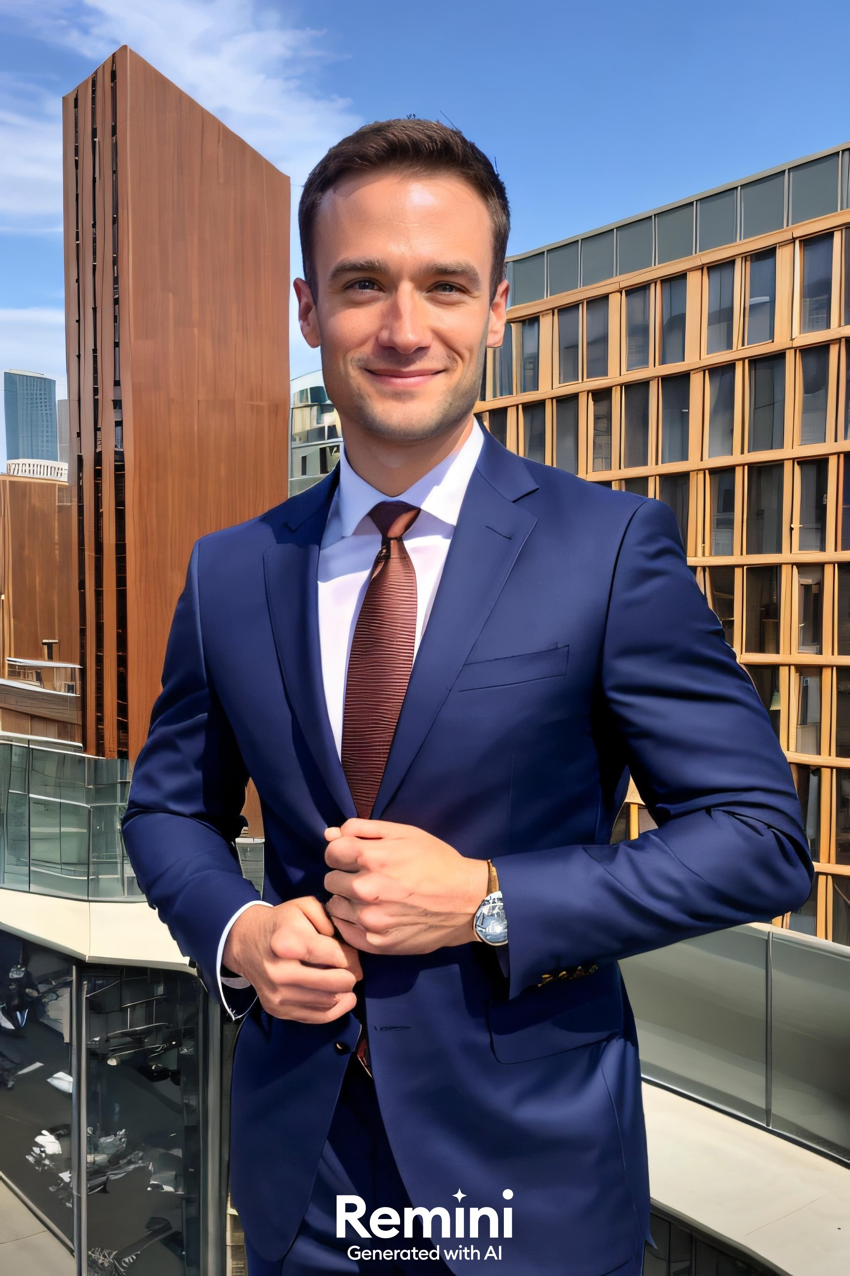
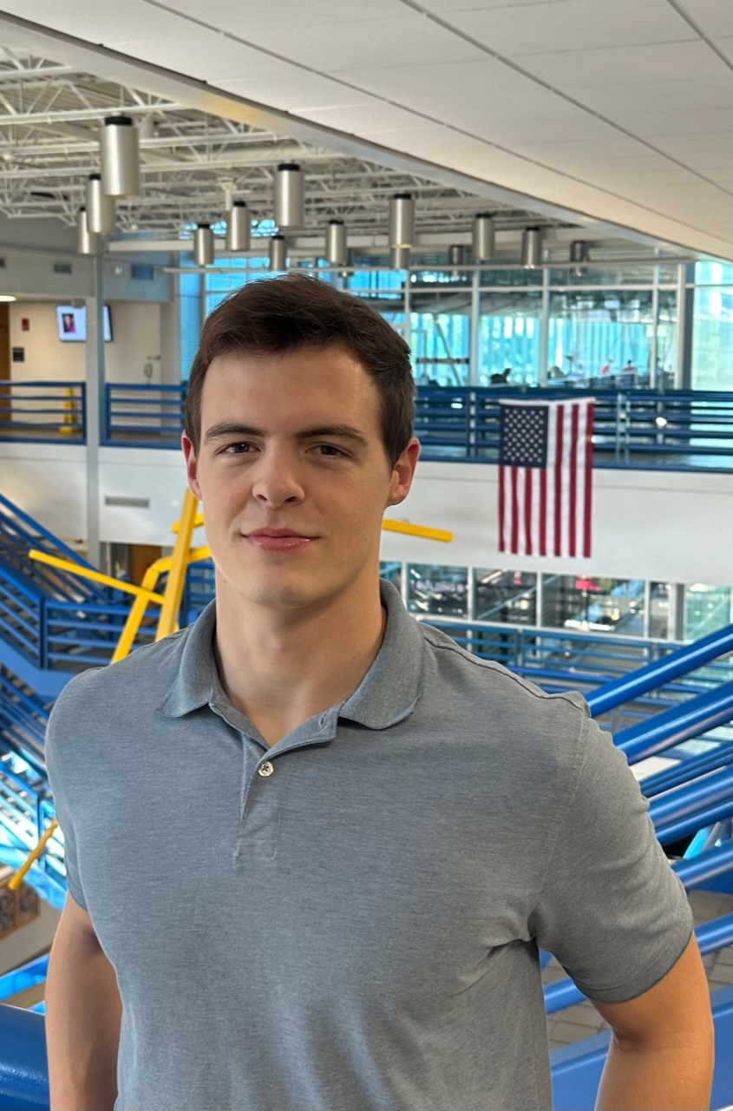

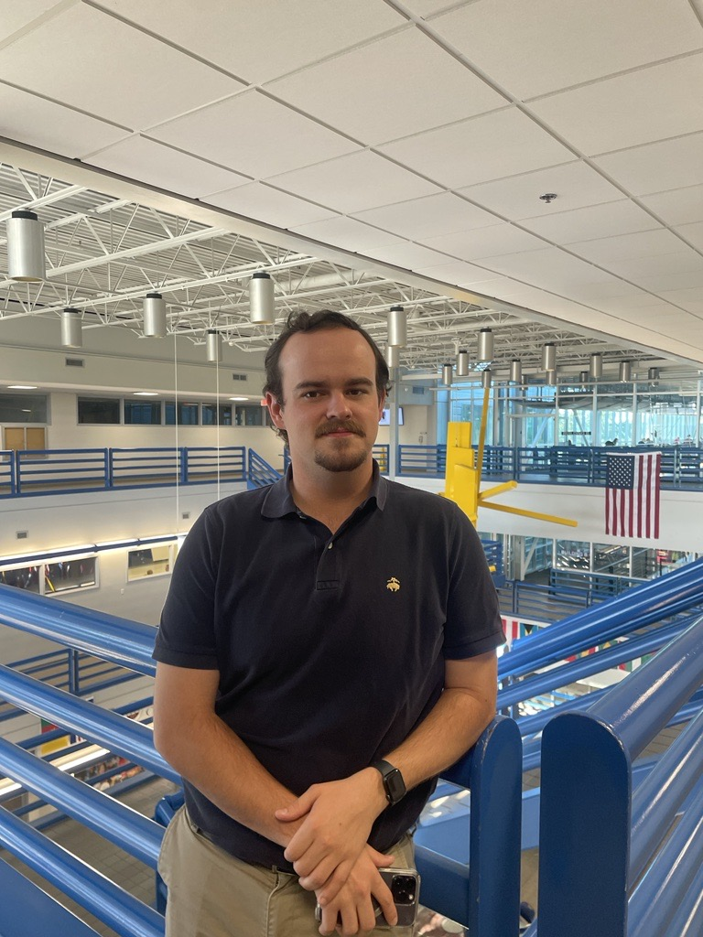


Team Introductions
Evan Cloutier
Project Manager
Nick Billmire
Digital Communication Engineer
Jada Davis
Software Engineer
Landon Hicks
PCB Design Engineer
Austin Roberts
Signal Processing Engineer
Dallas Toth Test Engineer

Slide 3
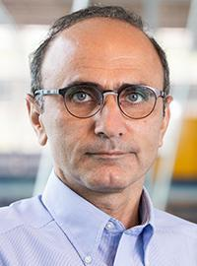
Sponsor and Advisors
Sponsor
L3Harris Technologies
Faculty Advisor
Babak Noroozi, Ph.D.
Professor

Slide 4
Original Project Scope
Multi-Axial Angular Sensor:
A form/fit/function replacement
Design a circuit card assembly for a provided sensor
Develop code needed to output the proper message format
Construct the card within given size limitations
Regulate power to the sensor
Output in RS-422 message format

Slide 5
Project Scope
Design a circuit card assembly
Acquire data from angular sensor
Develop code to process signals and output in a standard message format
Regulate sensor power
Investigate data transmission with RFID
Description: A circuit card assembly that samples, interprets, and outputs the signals of a selected inertial measurement sensor suite

Slide 6
Stakeholders & Applications
Ourselves & C.O.E.
L3Harris
Aerospace Companies
Tracking object velocity/acceleration
Tracking object orientation
Location with respect to Earth’s magnetic field

Slide 7
Customer Needs
Given that the former sponsor will not be collaborating with us on the design, we will be creating our own customer needs.
Original Statement - ”For it to be a form/fit/function replacement we’ll provide a mechanical design and a selected sensor. The students will need to design the CCA interface for it and develop the code needed to output the proper message format. We will provide a specification that will dictate the QTY(2) required connectors and the size limitations of the CCA. The students will need to design the CCA to regulate power to the sensor, manage inputs and outputs of the sensor, process sensor output and format to an RS-422 output.”

Slide 8
Technical Challenges
Ensuring compatibility between hardware components.
Power distribution among components.
Sensor range, resolution, external noise.
Sampling frequency.
Test and evaluation in latter stages.

Slide 9
Project Management
Project Manager: Evan Cloutier
Developing a project plan/timeline, delegating tasks, finalizing documents, communicating with advisors, and assisting team members when needed.
PCB Design Engineer: Landon Hicks
Design the physical circuit card, including the circuits themselves (when appropriate), their placement and routing.

Slide 10
Project Management
Embedded Software Engineer: Jada Davis
Design and maintaining embedded software implemented in the project, as delegated by the project manager.
Signal Processing Engineer: Austin Roberts
Processing of data from the angular sensor, as delegated by the project manager.

Slide 11
Project Management
Digital Communications Engineer: Nicholas Billmire
Implement sensor system output in the proper message format and assist the PCB design engineer with proper connections/hardware configuration.
Test Engineer: Dallas Toth
Designing, implementing, and executing test plans, as well as documenting defects when redesign is needed.

Slide 12
Project Background
Nicholas Billmire

Slide 13
IMUs + MCUs + RS422
IMU
Comprised of accelerometers, gyroscopes, and magnetometers.
Measure orientation, velocity, and gravitational forces.
Used in navigation, motion tracking, and stabilization.
MCU
Designed for embedded systems and real-time applications and can execute pre-programmed tasks or control external hardware based on input from sensors or user interfaces.
RS-422
Serial protocol known for its differential signaling, providing high noise immunity and longer cable distances. Advantages include no direction control i.e., path independent transmission & receiving.

Slide 14
RFID (Radio-Frequency Identification)
A technology that uses radio waves to wirelessly identify objects within a proximity.
RFID tags store data and are affixed to objects. RFID readers that send and receive radio signals to interact with the tags.
Applications included access control, payment systems, logistics for efficient and automated tracking and ID purposes.
Potentially can be used as a means of data transmission.

Slide 15
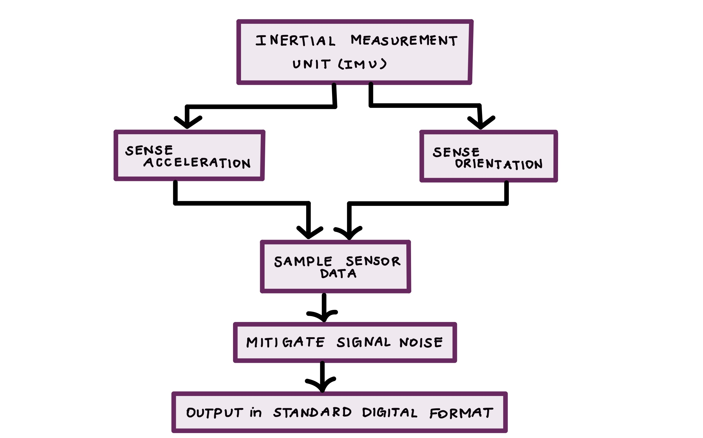
Functional Decomposition

Slide 16
Next Steps for Fall…
Concept Generation + Selection
Work Breakdown Structure
Component Selection
Detailed Design
Bill of Materials
Notes:
Our team has experienced considerable delays in the beginning steps of our project. For the rest of the fall we will be progressing to the best of our ability to reach our end goals. This includes weekly meetings with our advisor, Dr. Noroozi, for continued guidance on the best courses of action, whilst we await any further responses from our customer, L3Harris. Currently we are conducting research on the components needed for the final deliverable, learning how each correlates with the others. We will also work on completing the remaining preliminary steps assigned by Dr. Hooker to assist us in gaining a better understanding of the project. The concept generation and selection will be where we utilize our research to brainstorm a feasible design that we will work with for the rest of the project. We will finalize and describe our design while completing the component selection and detailed design and present it to our advisor for final critiques. This will allow us to configure an accurate Bill of Materials and put the team in a great spot to begin physical implementation in the Spring.

Slide 17
Thank You! Questions?

Slide 18
Backup Slides

Slide 19
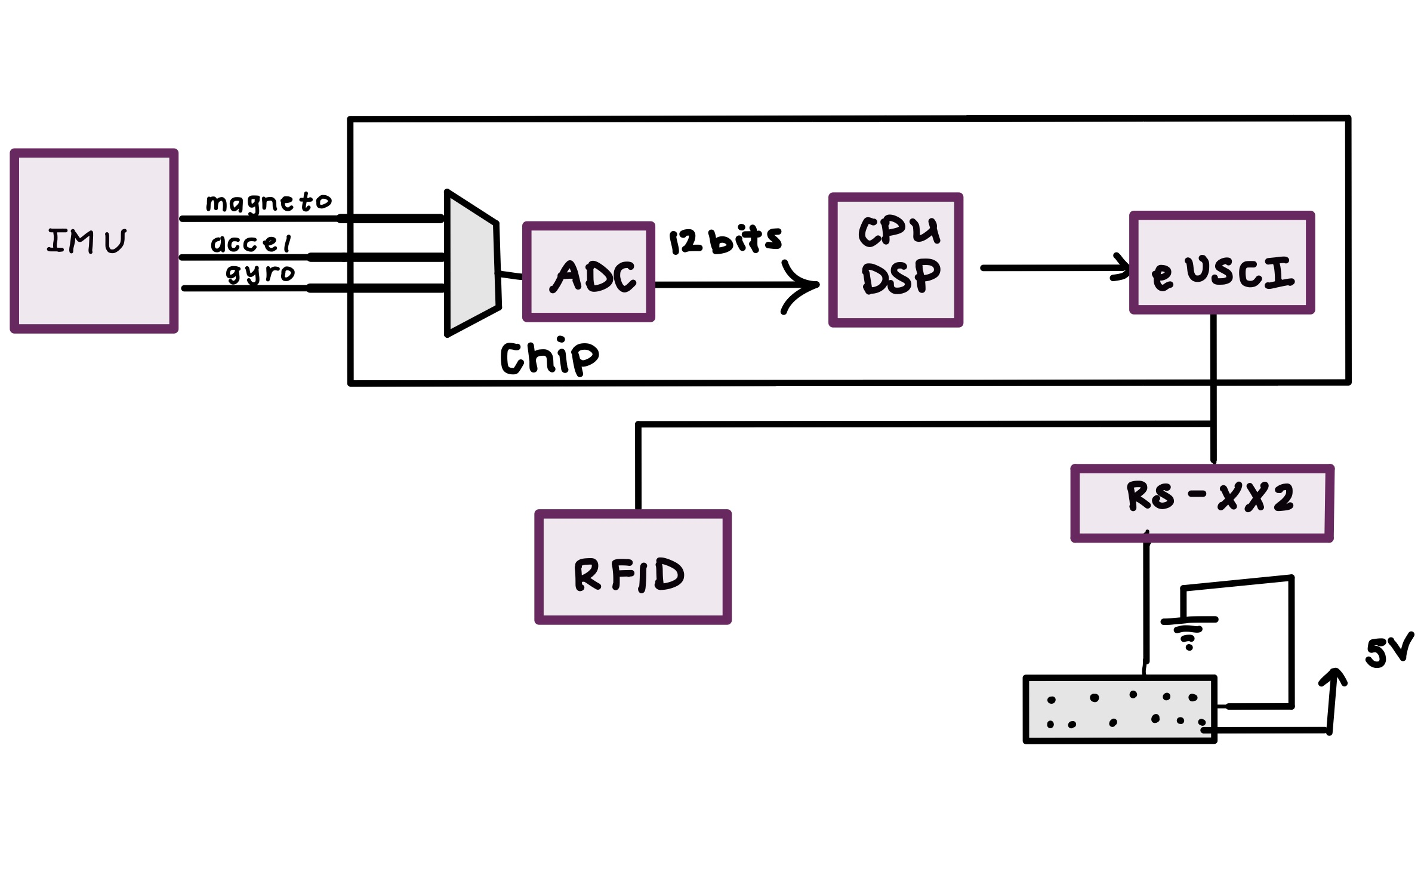
High-Level Design

Slide 21
Slide Headline
Try to keep text at 16 pt minimum.

Slide 22
Slide Headline
Try to keep text at 16 pt minimum.
Try to put as few words as possible on the slide if you’re using for a presentation.

Slide 23
Slide Headline
Try to keep text at 16 pt minimum.
Try to put as few words as possible on the slide if you’re using for a presentation.
Mix and match the backgrounds as shown in this template or just use one throughout.

Slide 24





Slide Headline
Try to keep text at 16 pt minimum.
Try to put as few words as possible on the slide if you’re using for a presentation.
Mix and match the backgrounds as shown in this template or just use one throughout.
You can put department/unit logos in slide master at Horizontal 0.89” Vertical 6.44” From top left corner

Slide 25
This is 10-point
This is 15–point Times
This is 20–point
This is 25–point
This is 30–point
This is 35–point
This is 40–point
This is 50–point
This is 60–point
This is 72–point
Notes:
Use at least 20-point font in Room A105, B134, and B136
Use at least 25-point font in Room B135

Slide 26
College of Engineering Color Palette
1 2 3 4
Pantone: PMS 195 C
RGB: 120, 47, 64
Hex: #782F40
CMYK:19, 90, 50, 55
1 2 3 4
Pantone: Black C
RGB: 0, 0, 0
Hex: #000000
CMYK:0, 0, 0, 100
Garnet
Black
1 2 3 4
RGB: 238, 118, 36
Hex: #EE7624
CMYK:2, 66, 99, 0
1 2 3 4
Pantone: PMS 000C
RGB: 255, 255, 255
Hex: #FFFFFF
CMYK: 0, 0, 0, 0
Fang
Orange
White
Notes:
Avoid 75% Black in B135

Slide 27
Accent Color Palette
1 2 3 4
RGB: 0, 59, 111
Hex: #003B6F
CMYK:
1 2 3 4
RGB: 0, 59, 111
Hex: #003B6F
CMYK:
1 2 3 4
RGB: 251, 236, 93
Hex: #FBEC5D
CMYK:
1 2 3 4
RGB: 219, 215, 210
Hex: #DBD7D2
CMYK:
1 2 3 4
RGB: 251, 236, 93
Hex: #FBEC5D
CMYK:
1 2 3 4
RGB: 219, 215, 210
Hex: #DBD7D2
CMYK:
Tardis Blue
Tardis Blue
Corn
Timberwolf
Corn
Timberwolf
1 2 3 4
RGB: 206, 0, 88
Hex: #CE0058
CMYK: 0, 100, 43, 12
1 2 3 4
RGB: 206, 0, 88
Hex: #CE0058
CMYK: 0, 100, 43, 12
1 2 3 4
RGB: 104, 40, 96
Hex: #682860
CMYK:
1 2 3 4
RGB: 220, 220, 220
Hex: #DCDCDC
CMYK:
Rubine Red
Rubine Red
Imperial
Gainsboro
1 2 3 4
RGB: 72, 146, 155
Hex: #48929b
CMYK:
1 2 3 4
RGB: 64, 224, 208
Hex: #40E0D0
CMYK:
1 2 3 4
RGB: 255, 139, 0
Hex: #FF8B00
CMYK:
Asagi-iro
Turquoise
American Orange
Notes:
Remove American orange add hyperlink grey
Make corn the last for b135
All work in 134 imperial move later
Tardis doesn’t work in b136

Slide 28
F7AB19
D67F15
EE7624
D64615
F73119
Analogous
https://color.adobe.com/create/color-wheel
6E3610
F0A16C
EE7624
6E4931
BASB1C
Monochromatic
A14508
4BED3B
EE7624
250CED
2010A1
Triad
A1470C
FF8C40
EE7624
0098A1
24E2ED
Complementary
28A164
2FED8D
EE7624
0848A1
1871ED
Split Complementary
EDAC2F
3BED93
EE7624
0C6AED
ED2F18
Double Split Complementary
ED660C
C7ED3B
EE7624
0CE1ED
A418ED
Square
BA7E09
87724A
EE7624
60EFCF
09BA61
Compound
AD551A
6E3610
EE7624
FA7625
D46820
Shades
Notes:
These are the variants that work well with Fang Orange. The bolded items show well on the projectors.

Slide 29
85412D
8F3831
782f40
8F3176
792D85
Analogous
https://color.adobe.com/create/color-wheel
C44D69
8E626D
782F40
C48796
451B25
Monochromatic
C43959
78743B
782F40
236178
43A2C4
Triad
C43959
C46078
782F40
25C43D
2F783A
Complementary
93C460
577835
782F40
39C49D
297861
Split Complementary
784435
5A783B
782F40
237860
6E2978
Double Split Complementary
782337
78683b
782F40
237830
293978
Square
AB4D32
DEBAAF
782F40
5D8555
70AB32
Compound
38161E
C44D69
782F40
853447
5E2532
Shades

Slide 30
A105
A105
B135 Stage Left
B135 Stage Right
B136
B134, A105
B135

